Slide 1
BANK MANAGEMENT SYSTEM

Slide 2
INTRODUCTION
Add new customer account, delete account and user can also modify existing user account information.
Search any individual account in few seconds.
Using our bank management system user can also check any translation in any account.
Our system also provide security check to reduce fraud.
The system will check the user’s existence in the database and provide the set of services with respect to the role of the user.

Slide 3
Problem Statement
Consumption most of the human effort on manual Banking System.

Slide 4
PURPOSE
The main purpose of developing bank management system is to design an application, which could store bank data and provide an interface for retrieving customer related details with 100% accuracy.
This bank management system also allow user to add new customer account, delete account and user can also modify existing user account information.

Slide 5
MODULES
1) Create new Account
2)Deposit
3)Withdrawal
4)Transfer
5)Close Account

Slide 6
SYSTEM ARCHITECTURE

Slide 7
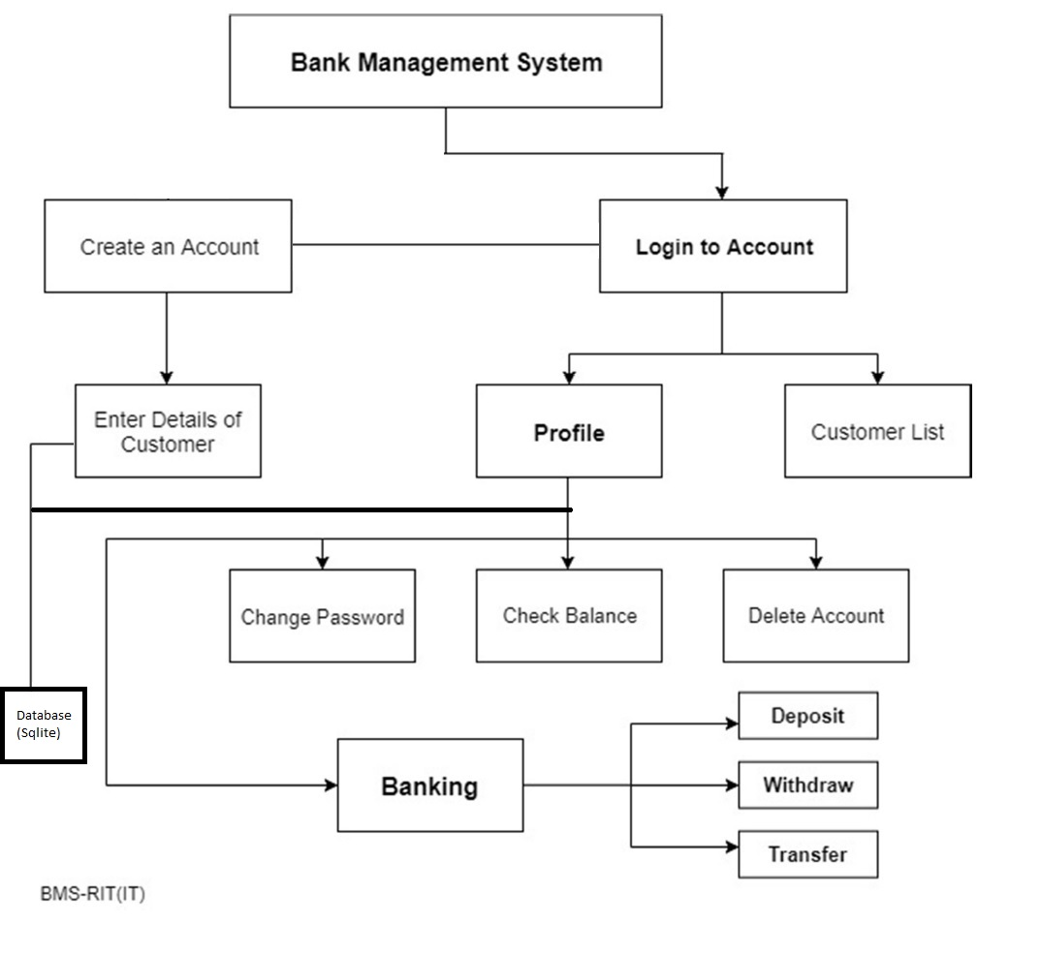

Slide 8
JDBC CONNECTIVITY
Loading driver class
Creating connection
Creating statement
Executing queries
Getting result
Closing connection

Slide 9
Application
1.It is used in banking applications to Create New Account
2.it is used by customer to Check Balance
3.Used by banking authorities to record Deposit Money
4.Used by banking authorities to record Withdrawal of Money
5.Used by banking authorities to existing customer Close Account
6.Used in online banking to reduce the manual banking and make banking easier.

Slide 10
THANK YOU

